Slide 1
Project: 3D Apartment with Dynamic Objects
Roll: 1907031
Features:
Dynamic objects
Interior and Exterior textures
Curvy objects
Phong Shading for lights
Curve and cube texturing
Bird’s eye view
Logical controls such as car can’t go out when garage door is closed

Slide 2
Dynamic Objects
Features:
A car moving around the entire apartment including reasonably smooth curvy turns
Two swings having real physics effect such as pushing and friction
Lift going between two floors
Traditional and sliding doors
Curvy Objects
Features:
Implemented basin, bathtub, toilet and pillow using Bezier curve and cylinders

Slide 3
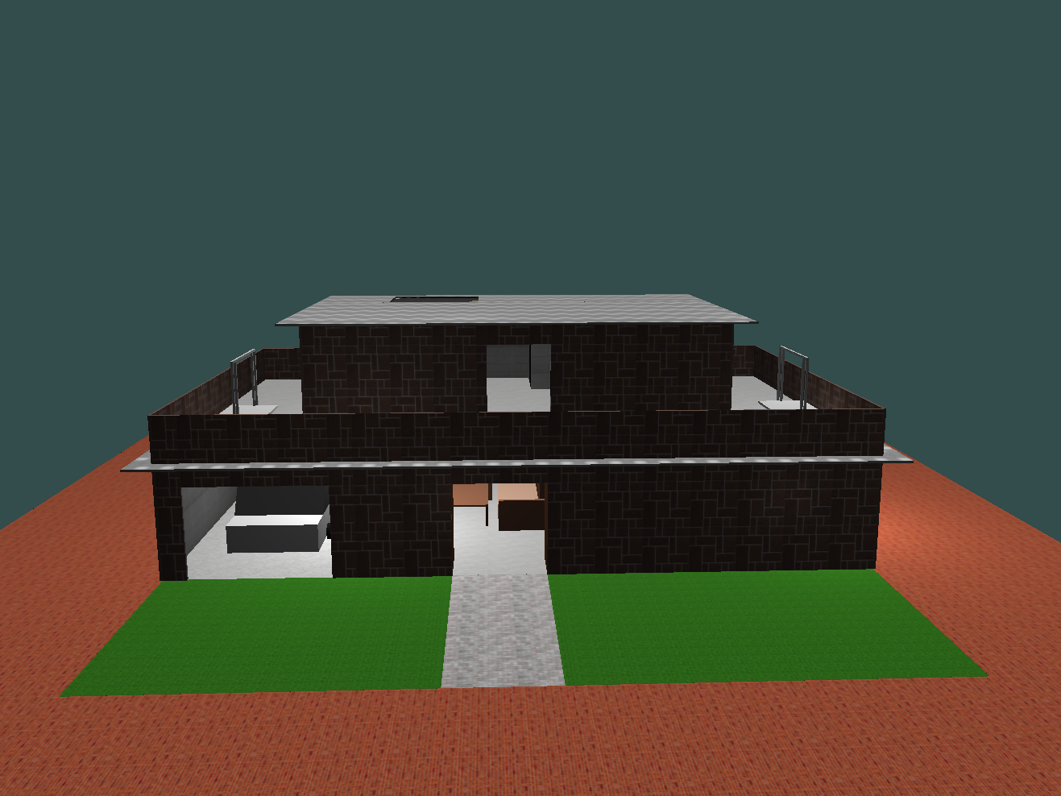
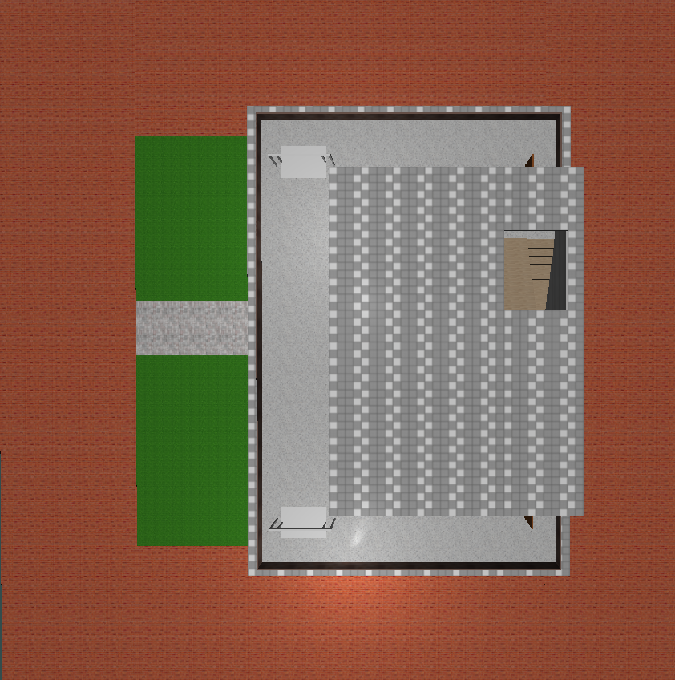
Fig 1: (a) Exterior front view
Fig 1: (b) Exterior Bird’s Eye View

Slide 4
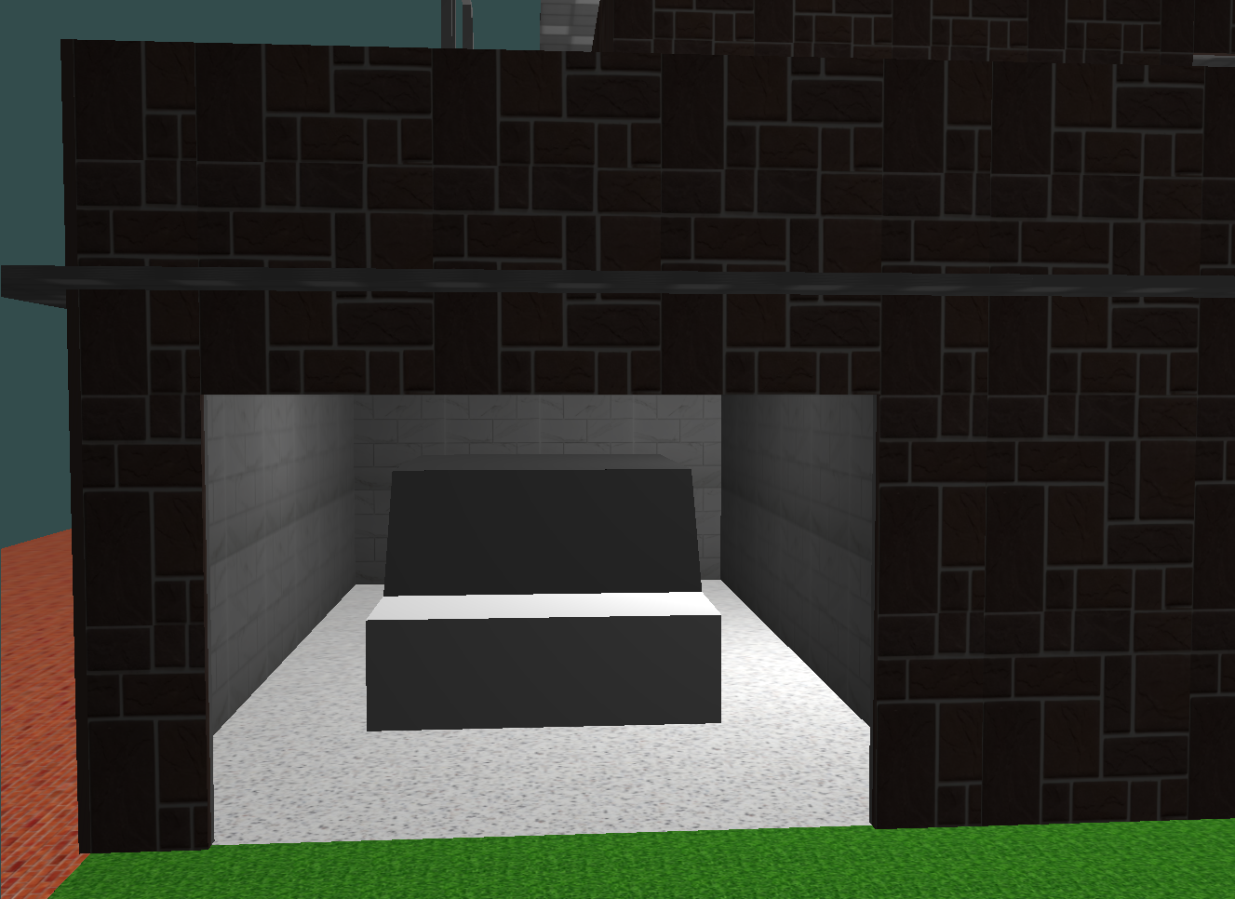
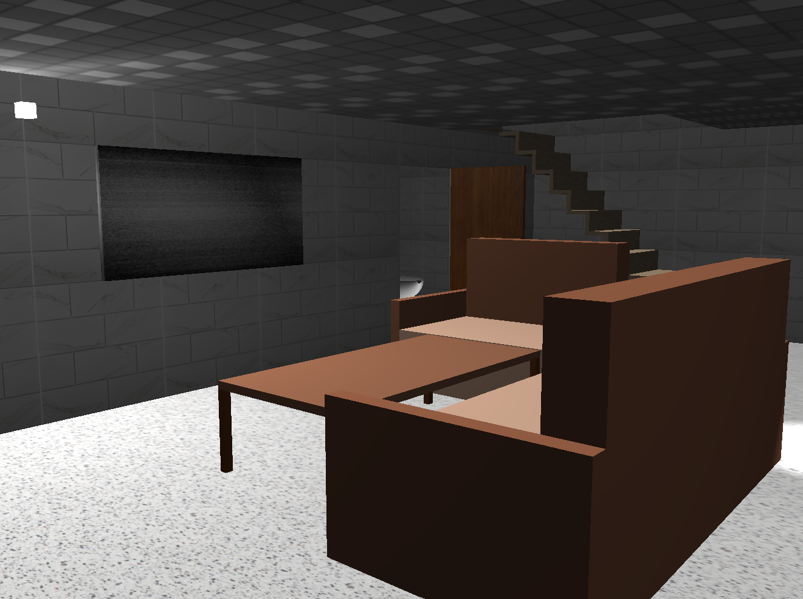
Fig 2: (a) Garage with car
Fig 2: (b) Living room

Slide 5
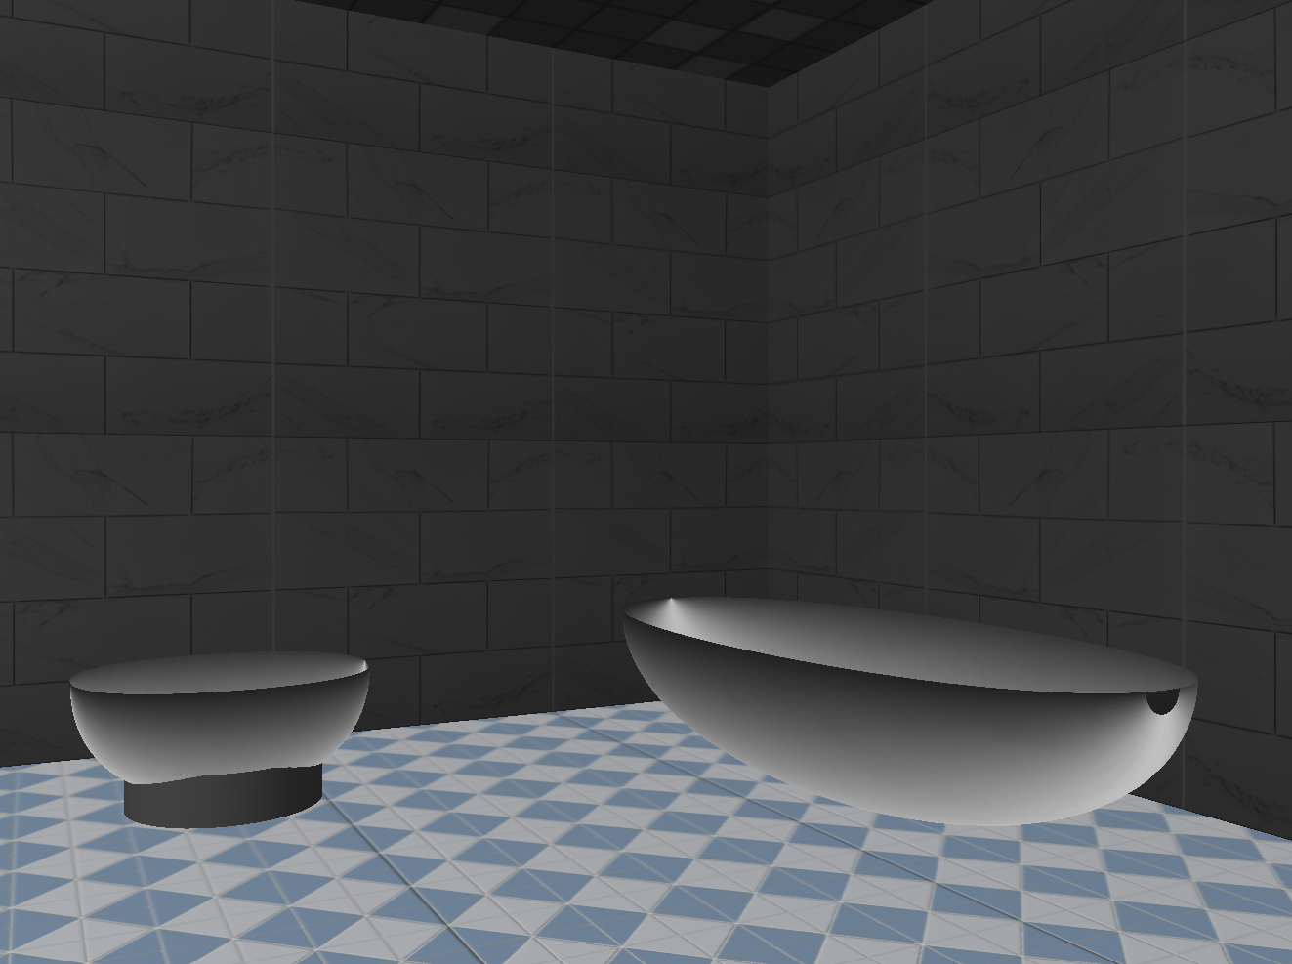
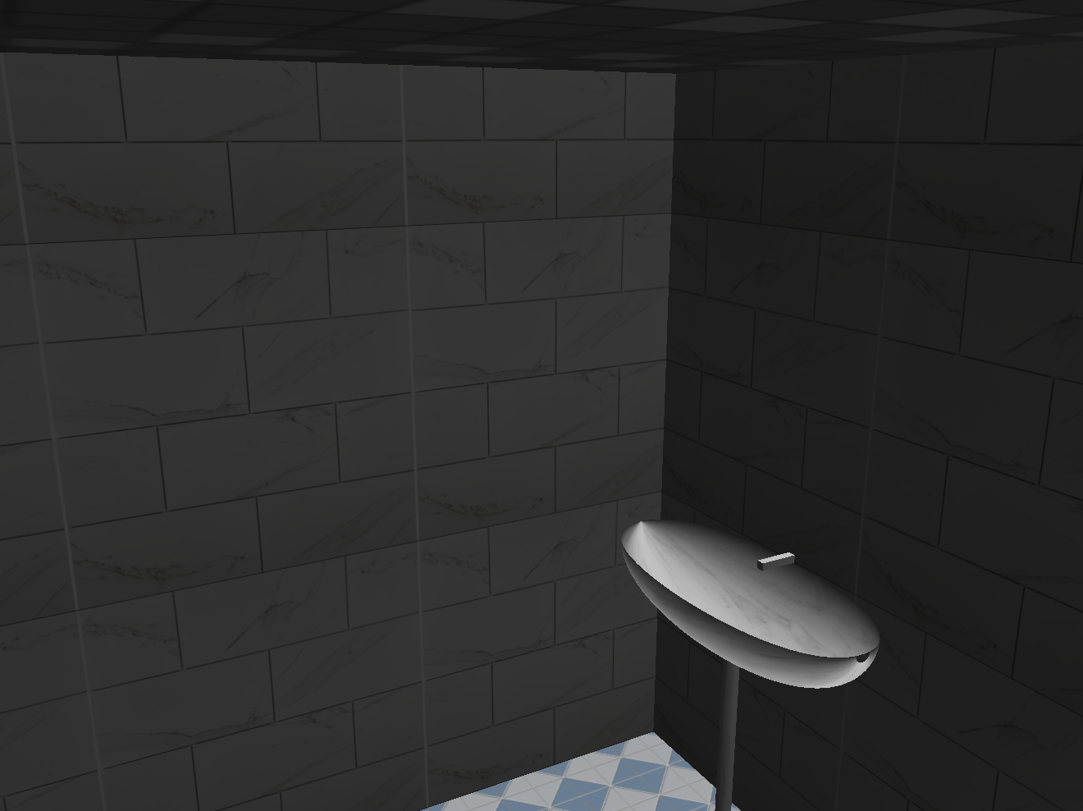
Fig 3: (a) Toilet and Bathtub
Fig 3: (b) Basin

Slide 6
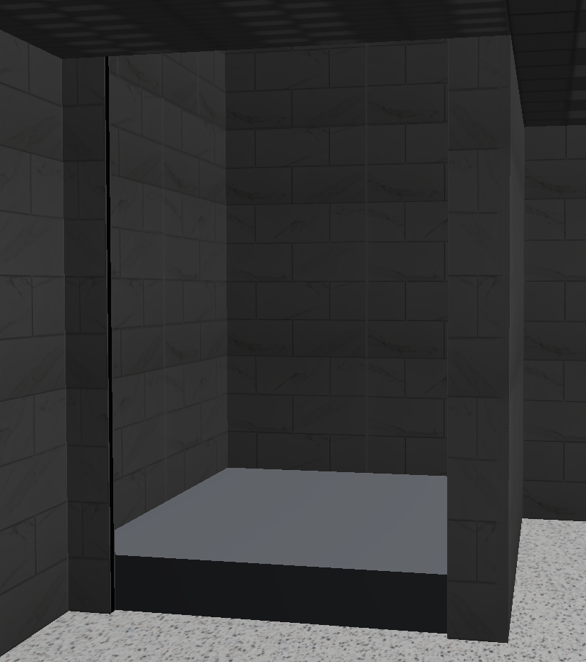
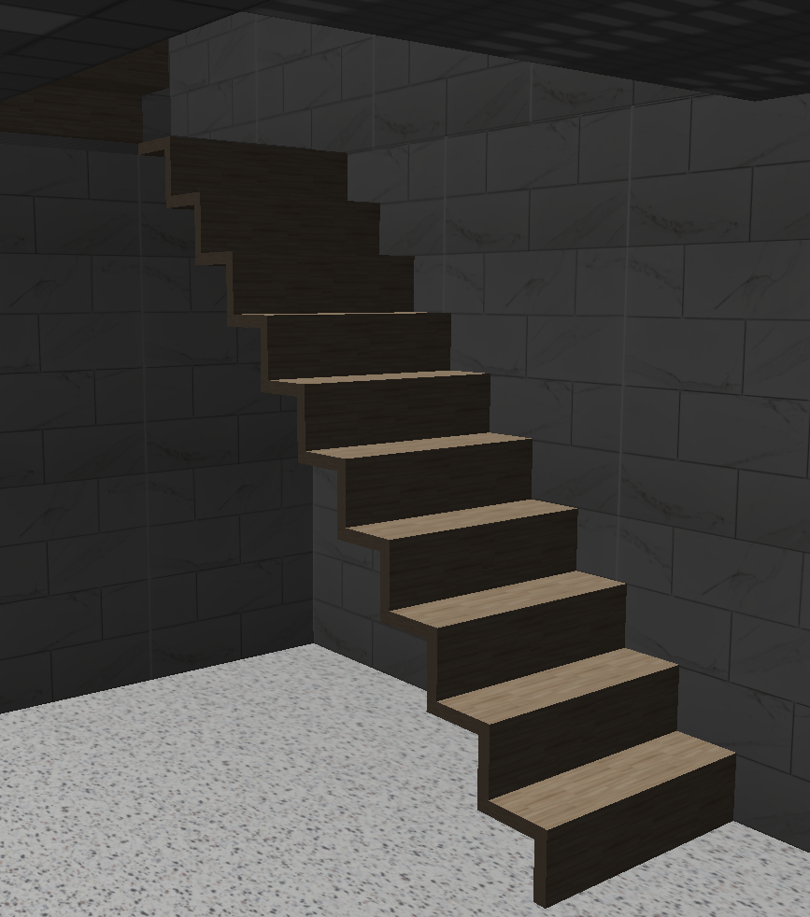
Fig 4: (a) Lift
Fig 4: (b) Stairs

Slide 7
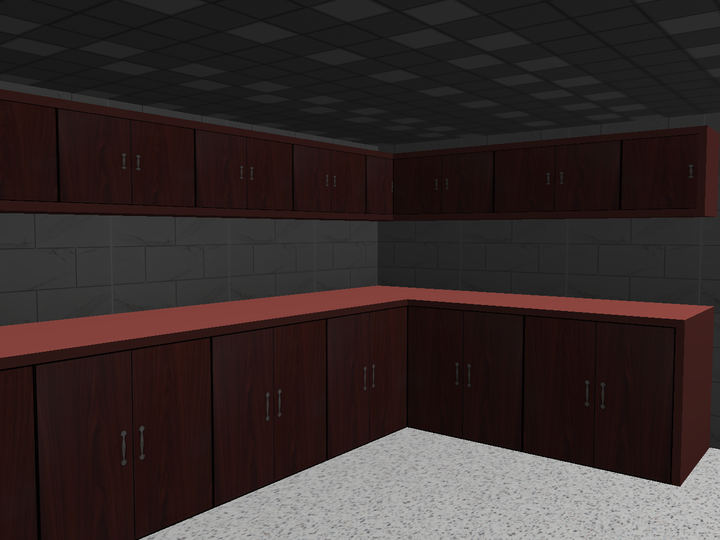
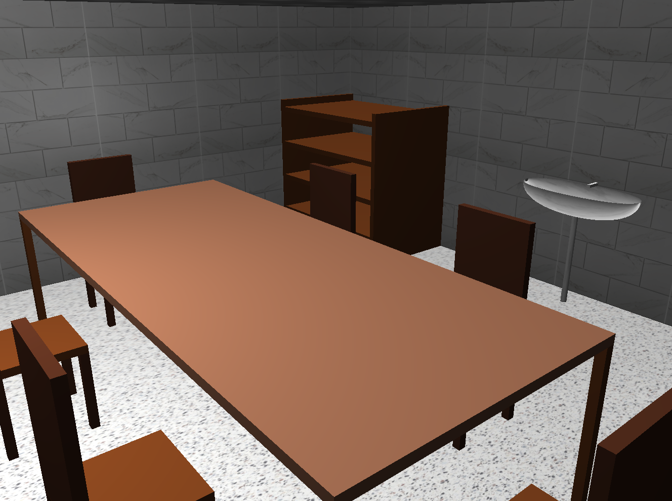
Fig 5: (a) Kitchen
Fig 5: (b) Dinning room

Slide 8
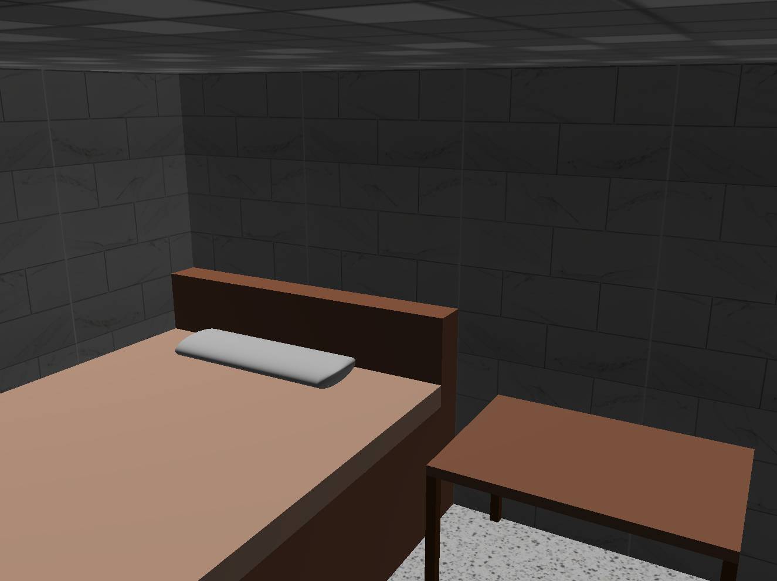
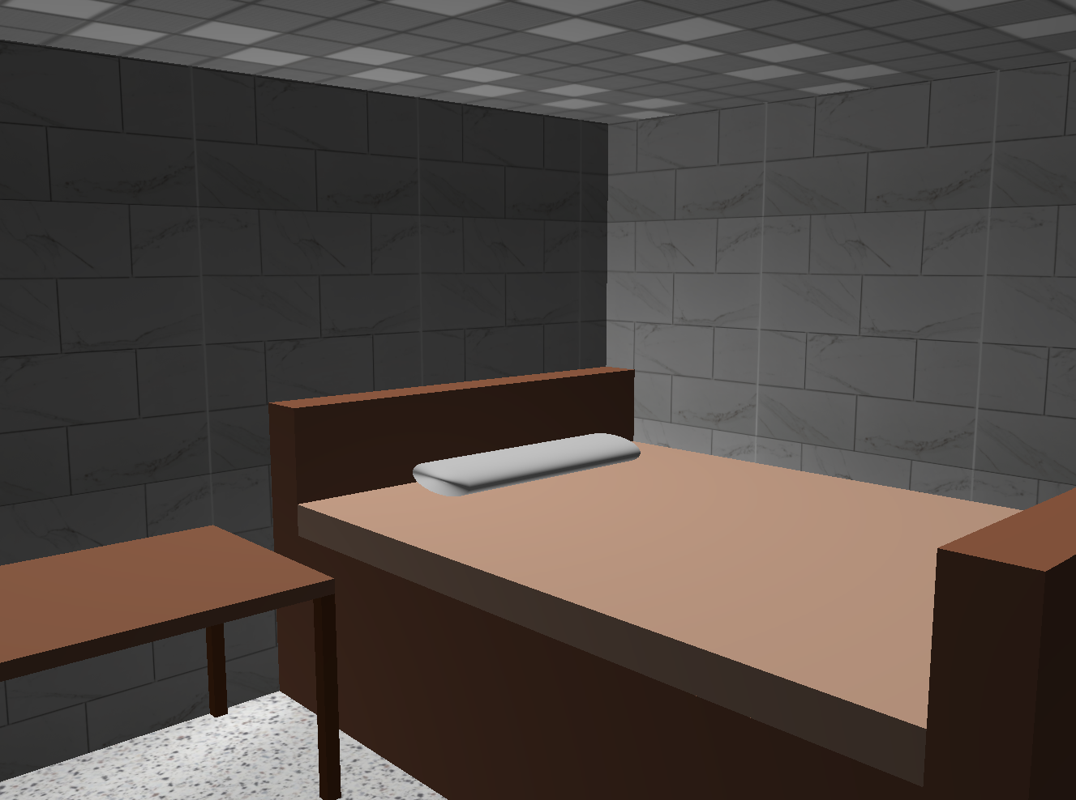
Fig 6: Bedrooms

Slide 9
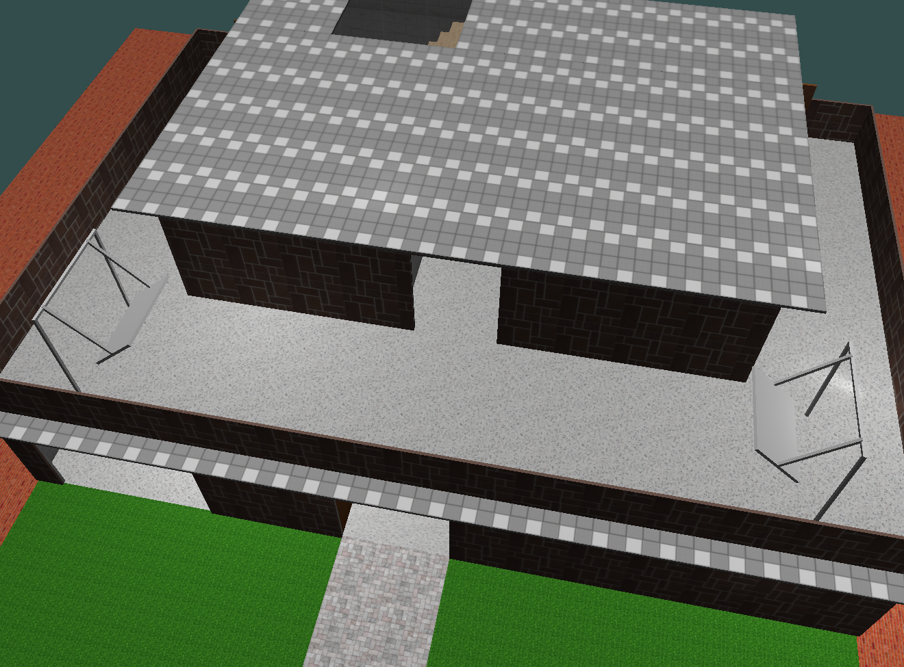
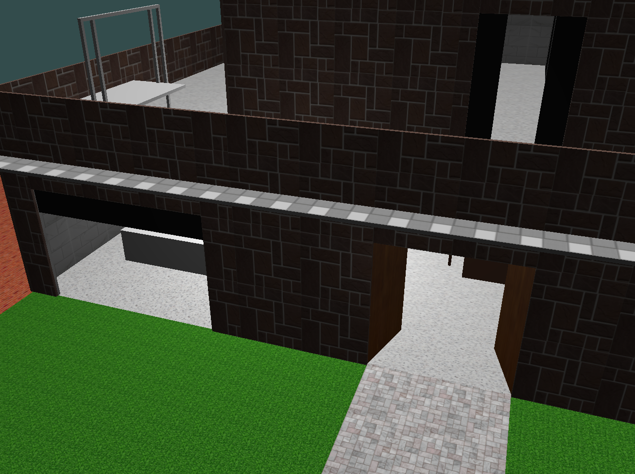
Fig 7: (a) Swings
Fig 7: (b) Doors closing and opening

Slide 10
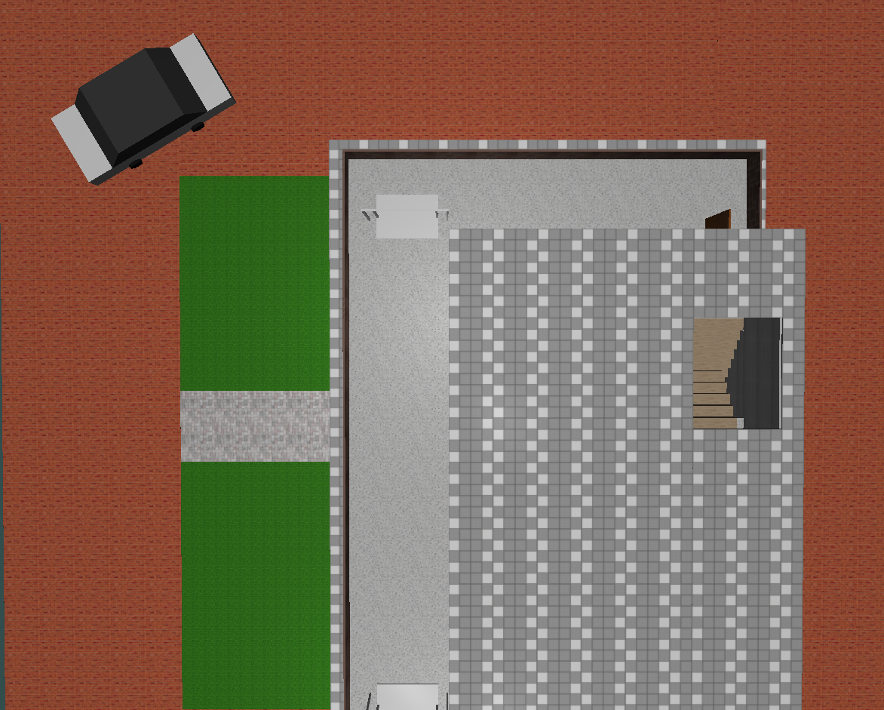
Fig 8: Dynamic car movement

